Slide 1
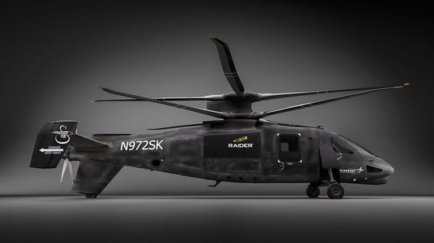
Future Fast Rotorcraft Progress Meeting 02 – 11/10/2023
Y.J.E. Prencipe

Slide 2
Progress Overview Week 3-4
Literature study progress
General
Simulation
Control
Handling Qualities
Discussion points
Experiments
Papers/books needed

Slide 3
General Literature
History & Design Aspects

Slide 4
General Literature Progress
ABC rotors more in depth
XH-59A, vertical separation, stiffness, airfoils, wind tunnel experiments, LOS, differential controls
Kamov helicopters history
Coaxial rotors design aspects more in depth
Function of pusher propeller

Slide 5
Modelling

Slide 6
Modelling Summary
Coupling effects
Control phasing
Rotor speed reduction
HeliUM, HeliUM 2, GENHEL
LOS
Rotor model – BET, BEMT, VTM, experiments
Inflow model – PP, coaxial blending, multi-rotor inflow model (PPSIM), VM, complexity considerations
Flapping dynamics – flap modes, IBC & MBC
Propeller model – various comparable models, twist, experiments

Slide 7
Modelling Summary
Trim analysis – scheduling of propeller pitch, trim algorithms, validation & interpretation, trim targets
Validation ideas
Linearisation – mission profile, flight envelope point selection, scheme+code+example in Stevens
Model synthesis – after linearisation, stitched model, fuzzy theory

Slide 8
Control

Slide 9
Control Summary
Inner loop – SAS, response tracking (r,p,y)
Outer loop – attitude/velocity hold, idk of necessary?
Response types
Actuator rate and saturation effects, bandwiths and damping ratios
Delay block incorporation
Pusher propeller – manual or automatic
Linear controllers – PID, DI, EMF
Nonlinear controllers- (I)NDI, neural networks
Pseudo-control hedging (windup problems)

Slide 10
Control Summary
Control allocation
Ganging, optimization based (PI, WPI, GPI), DCA, DynCA, daisy chaining, INCA
Points of attention, command filtering, rate and position constraints incorporation
Control strategies – whisper mode, differential controls, response types (including FW types for high speed), rotor RPM controller
EMF – very promising, more in depth study, basic steps, implicit vs explicit, architecture, command delays, LQR
Mostly handy because its based on ‘ideal’ model which is based on desired HQ aspects, and can be changed quite

Slide 11
Control Summary
Model predictive control (basic)
Dynamic Inversion – also promising, mostly used for outer loop, needs control derivatives tho (various methods of finding these), slightly less robust than EMF
LQR basics – ‘optimal’ gain calculation method that can be used to solve gains in e.g. EMF-based control systems
Robust control methods – L2/H2/Hinf/H1 (very basic study, just 1 section in 1 paper)
Response types – more in depth (but still not complete) look at which are used

Slide 12
Handling Qualities

Slide 13
Handling Qualities Summary
ADS-33E/F, SAE AS94900, MIL-STD-1797B
[Berger, Blanken, 2022] used Attitude capture and hold, sum-of-sines tracking, break turns, and high-speed acceleration/deceleration, in piloted flight simulation at the NASA Ames VMS
Conduit (NLR uses it, I have slides)
Tier 1 specs – key requirements, enforced
Tier 2 specs – ‘check only’, more relaxed GM & PM, some FW HQ req’s from MIL-STD-1797B CAT A CLASS I can be used

Slide 14
Discussion Points

Slide 15
Discussion Points
Piloted flight experiments at SIMONA?
Increases workload (to what extent?, how many extra weeks?)
Good (and fun) way to check subjective handling quality (cooper harper) of controller in action
Would be a good opportunity to invite helicopter test pilots – career in flight test (EFT, NLR, …)
Access to VTOL papers
Klyde D.H. "Piloted simulation evaluation of attitude capture and hold MTEs for the assessment of high-speed handling qualities"
Xin H. "Further development and piloted simulation evaluation of the break turn ads-33 mission task element"
Brewer R.L. "Further development and evaluation of a new high-speed acceleration/deceleration ads-33 mission task element"

Slide 16
Discussion Points
Change in 2 weeks off
Allowed to course Electronic Circuits, exam 02/11, practical 23/10 & 30/11
Aircraft noise has regulation that I can do the ‘old’ exam (noise & emissions) @ 06/11
→ 2 weeks off 23/10 – 06/11 (~1 week shift to the front)
Meeting would continue 25/10
How deep to go into certain topics before writing?
Personal deadlines written literature study
History, design aspects and modelling by 25/10 (feedback by 08/11?)
Control & handling qualities by fri 17/11 or sun 19/11? With potential feedback by 22/11?
Revisions by 1/12 + hand-in
Meeting Padfield tomorrow

Slide 17
Discussion Points
Current idea on thesis structure
History
Design Aspects
Model
Inflow model
Flapping dynamics
Trim procedure & analysis
Control
Linearization
WPI Control allocation
Inner loop EMF
LQR/CONDUIT Gain tuning
Gain Scheduling
Model stitching/Fuzzy-based model synthesis
Simulation results (step input tracking)

Slide 18
Discussion Points
Current idea on thesis structure
Handling Quality Assessment
(Piloted Flight Simulation?)
Attitude capture and hold
SoS
Combat Break turn
High speed acceleration/decelerration

Slide 19
End of Presentation.
Ynias J.E. Prencipe

